Slide 1
Social Engineering
For Executives

Slide 2

Whoami
G W Ray Davidson
Engineer, Georgia Tech/Purdue
(When the earth and internet were new)
Pharmaceutical Scientist
(Silicon Valley before the earthquake)
IT Project Leader
Professor – Networking & Security (Purdue)
Dean, SANS Technology Institute
VP, Knowledge Management, Syncurity
(Startup in N Virginia/DC)
Intelligent Threat, PhD, CISSP, GIAC 0x0A, NSFW, ETC

Slide 3

It’s Social, but is it Engineering?
Chemical engineers build explosives.
Aeronautical engineers build
delivery systems.
Civil engineers build targets.

Slide 4
Engineers build stuff.
Understand intrinsic properties
Physical
Chemical
Electrical
Aerodynamic
Pharmacodynamic
Computer-related
Design and implement systems based on those properties
Taking into account vulnerabilities

Slide 5
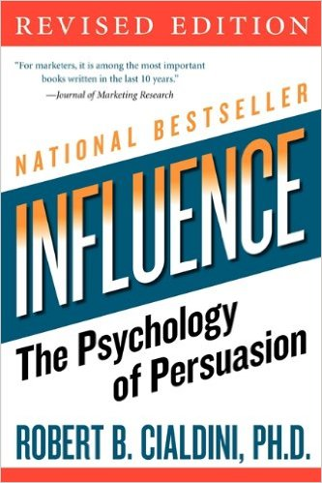
So Be a Social Engineer
Why do people act the way they do?
Evil social engineers know these principles and use them against you
Use them to build and lead a resilient organization

Slide 6
Reciprocation
Create a feeling of indebtedness to induce behavior
Evil examples
Nigerian prince
Holding the door
Chocolate for passwords

Slide 7
Commitment and Consistency
Our obsessive desire to be (and to appear) consistent with what we have already done.
Evil examples
Develop a relationship – regular innocuous contact
Ask a small favor first, then escalate
Combine with reciprocation

Slide 8
Social Proof – Wisdom of Crowds?
We look to others for approval, or at least reassurance
Evil examples
Group norms (smoking area)
Phishing – familiar or popular appeal
We all want to be “popular” (Wicked example)
Notes:
Apple sale at Christmas?

Slide 9
Liking
We do things for people we like
Attractive and similar
Evil examples
“Your friend suggested”
Mutual social media connections

Slide 10
Authority
Directed deference
Whoami
Evil examples
Milgram experiment
UPS uniforms
Clipboards

Slide 11
Scarcity
Supply and demand; scarcity drives value
Create pressure
Evil example
The boss needs this right away (combines with authority)
Limited time offer vs background checks

